Slide 1
Are you bored in quarantine?
Student: Plaian Nicoleta
Group: 1211EA
Faculty of Engineering in Foreign Languages
Coord teacher: sl. dr. ing. Mitrea Dan Alexandru

Slide 2
Contents
Programming languages used
Similar applications
Other examples
Why is my application different?
Objectives
Presentation of the application
Conclusion

Slide 3
Programming languages used:
HTML
CSS
JavaScript
Bootstrap

Slide 4
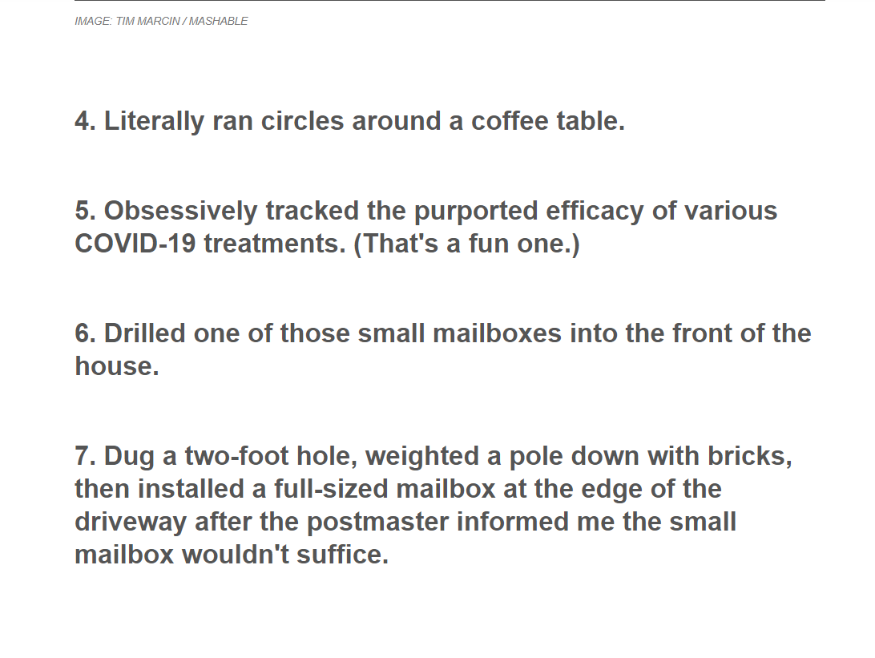
Similar applications
What you can find on the internet, by searching “bored in quarantine” or related words, are mostly:
articles describing how people got over their own boredom
simply listed suggestions of what you can do.
Companies that try to sell their products using the quarantine argument
This is an example from the first result I got after searching the words “bored in quarantine” →

Slide 5
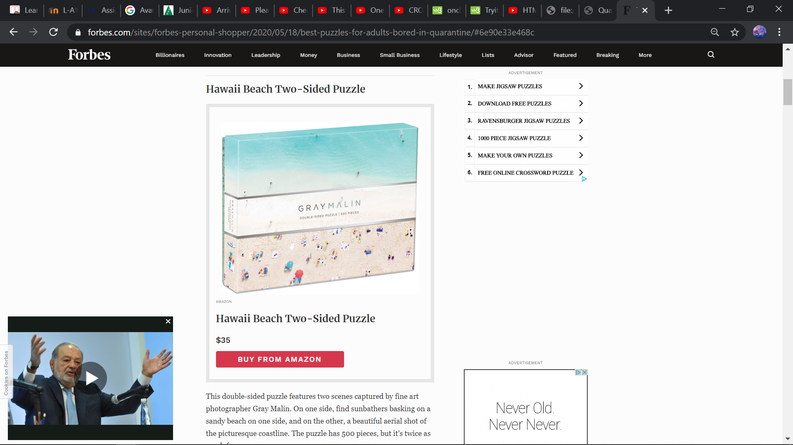
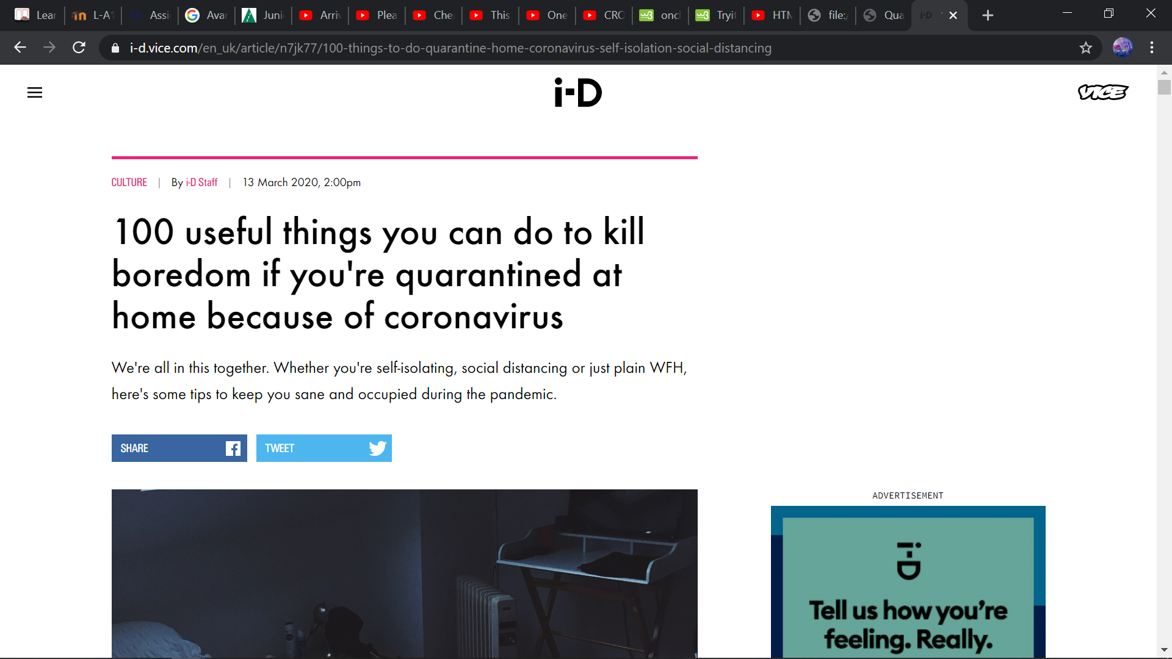
Other examples
On the left there we can see a website running a marketing campaign based on quarantine boredom and on the bottom an endless list of suggestions.

Slide 6
Why is my application different?
As we’ve seen, other websites include just suggestions or don’t really care about you at all and just try selling their product.
My application integrates suggestions with actual interaction with the user.

Slide 7
Objectives
“Are you bored in quarantine?” is a web application designed to stimulate your brain and lessen the boredom some people may experience during this period.
It contains 3 main parts related to 3 hobbies most people have: playing games, watching movies and listening to music.

Slide 8
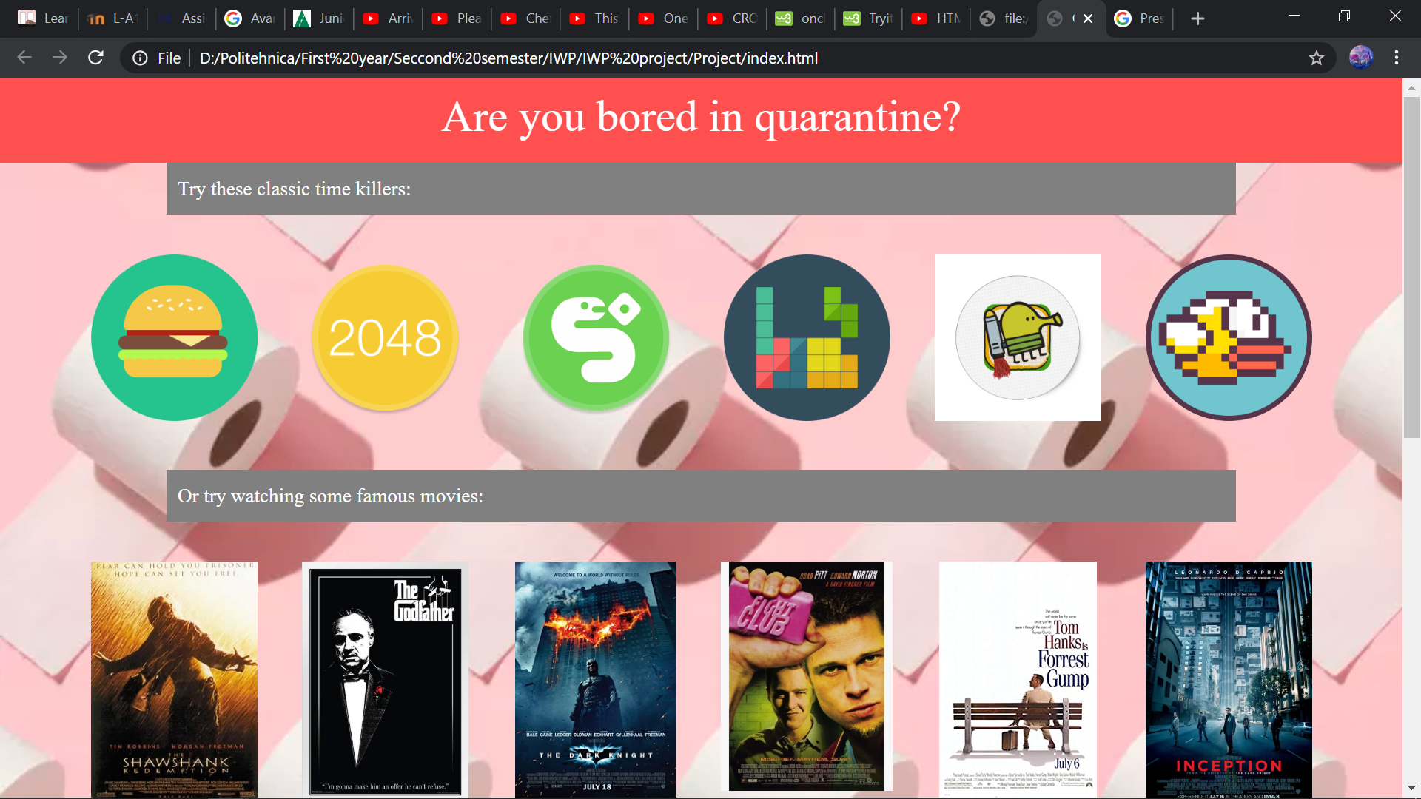
Presentation of the application
Layout of the application:

Slide 9
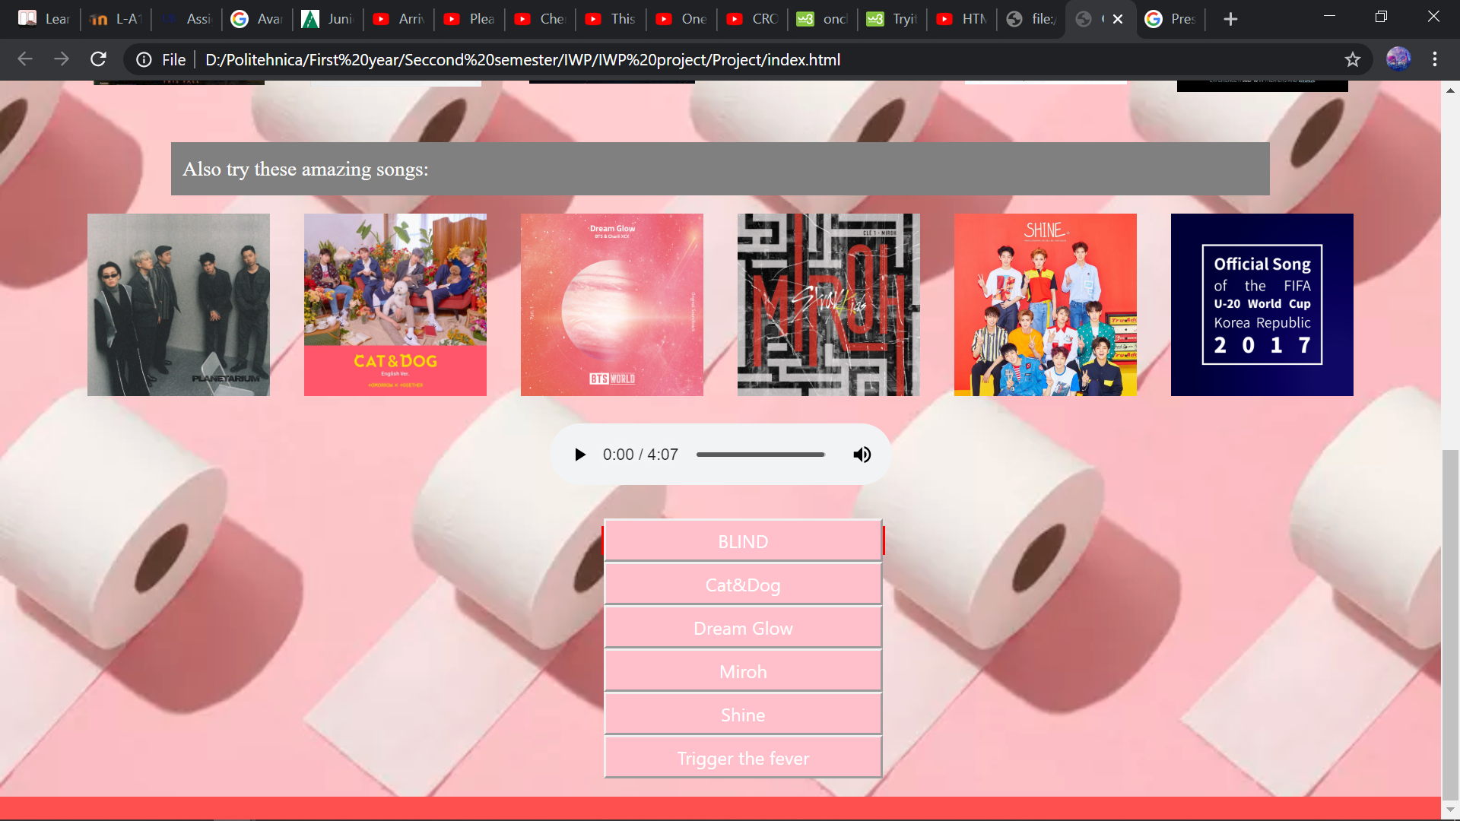

Slide 10
Vintage games
Who doesn’t like vintage games? They’re a total boredom killer.

Slide 11
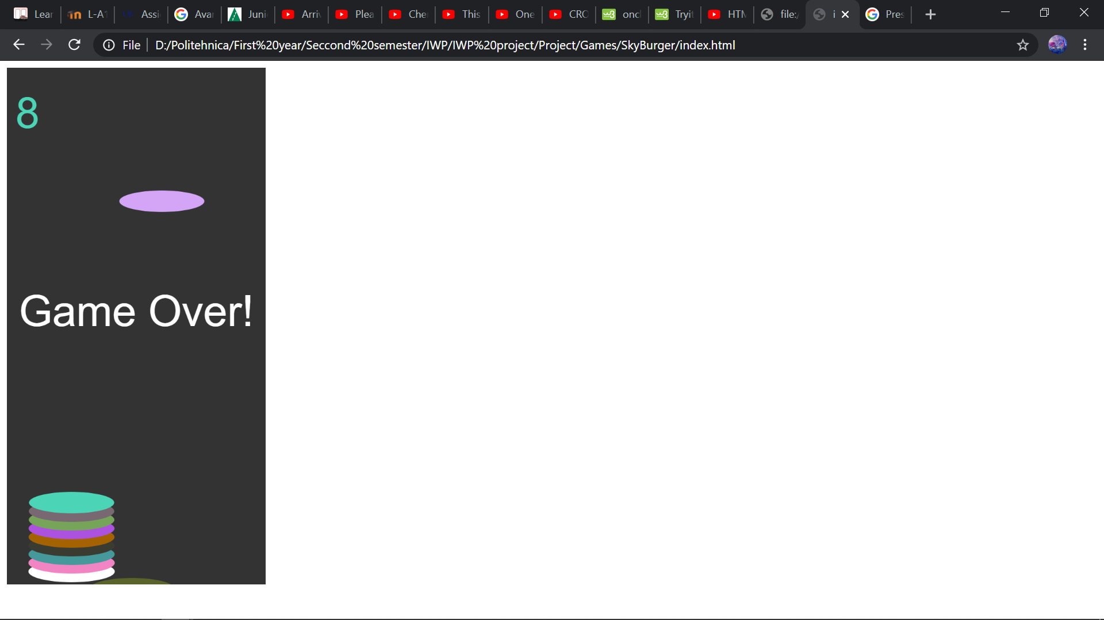
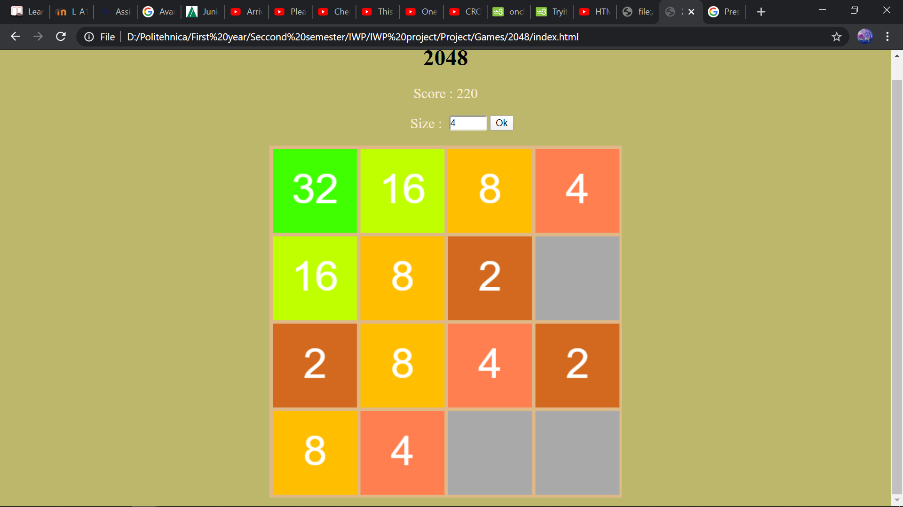
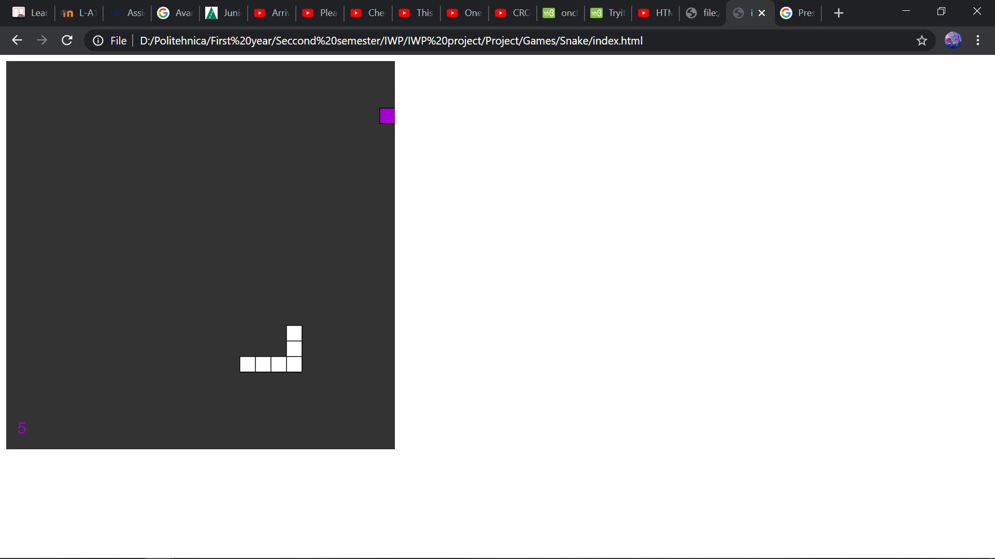
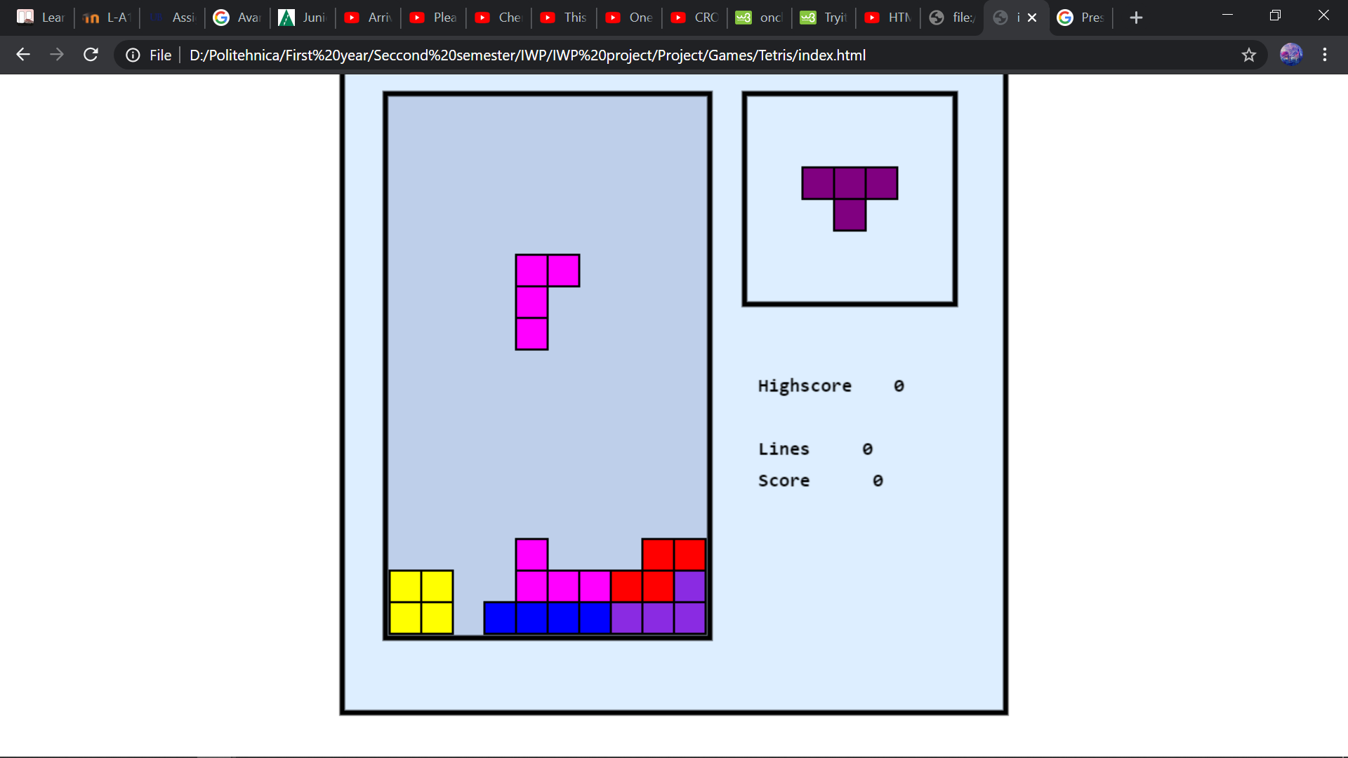
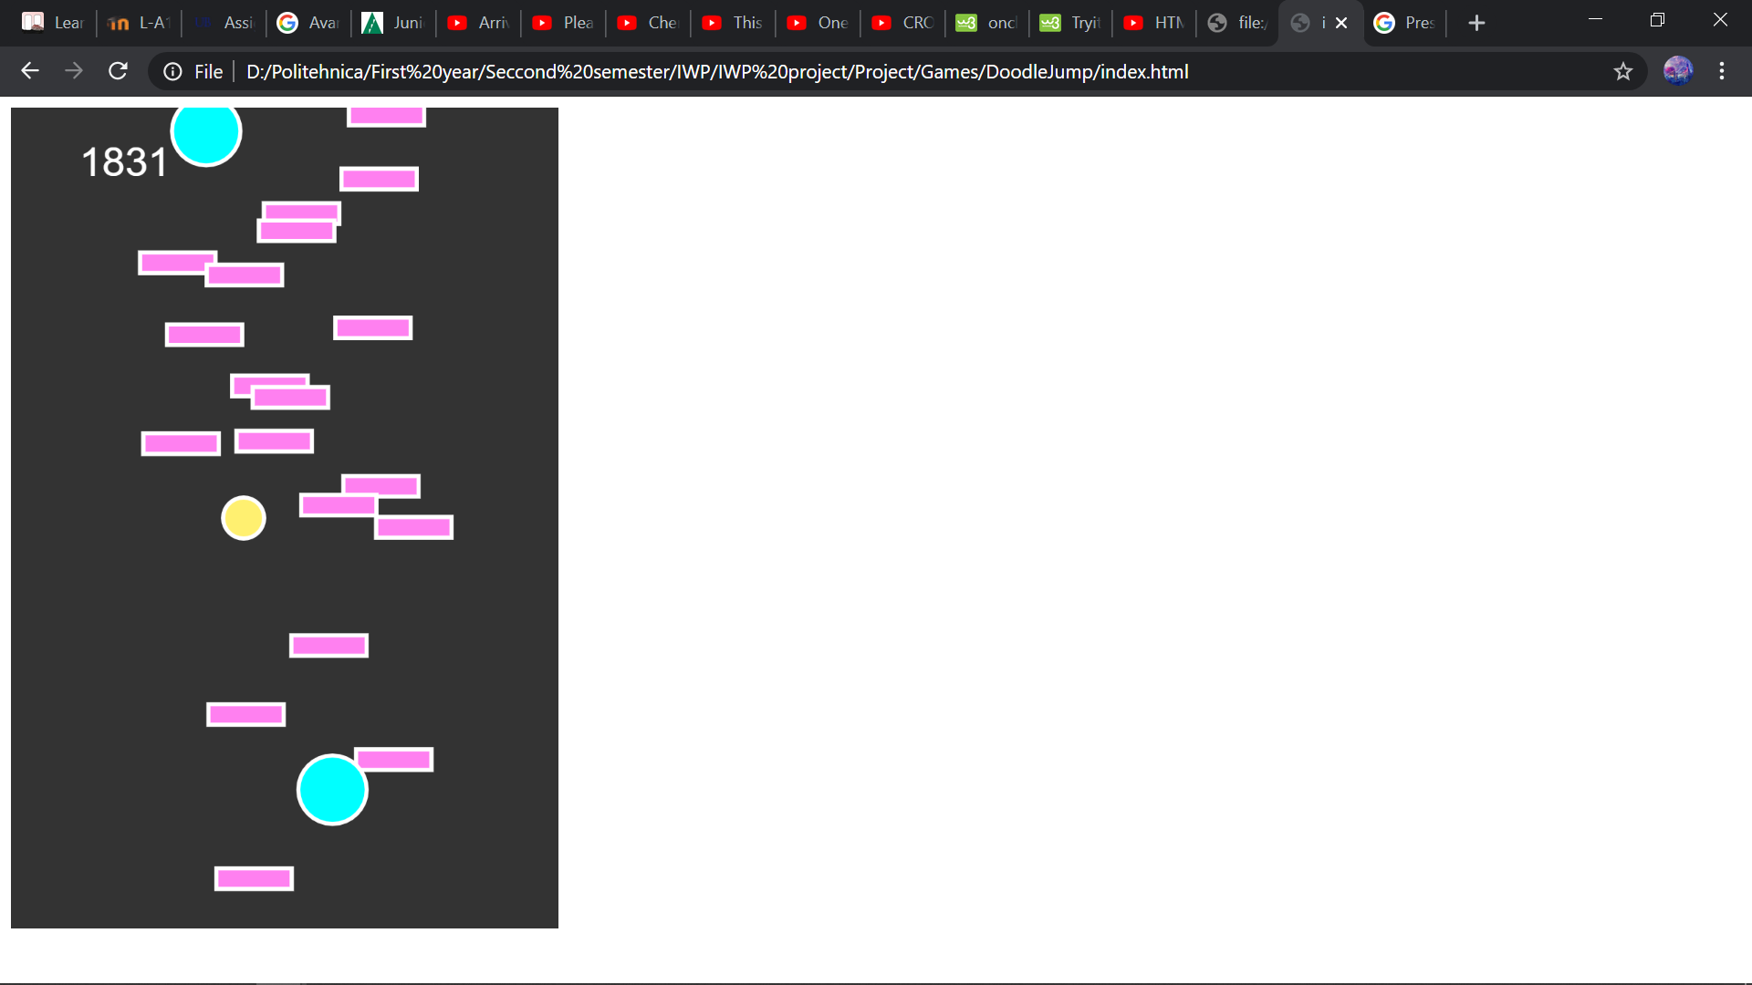
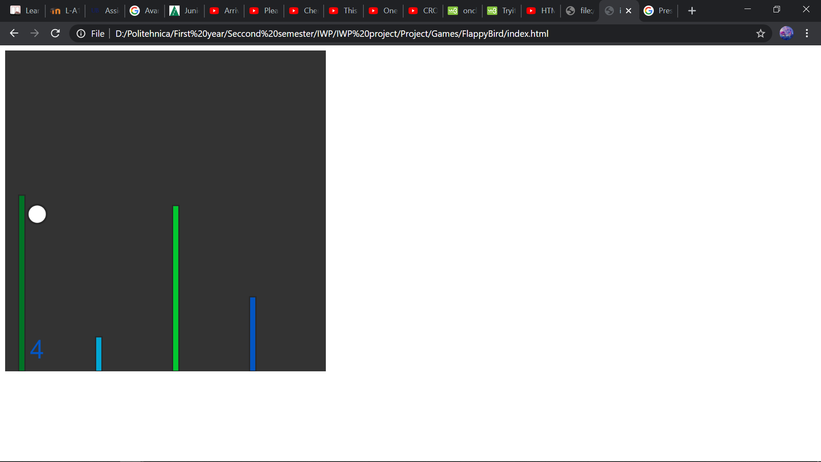

Slide 12
Movies
The posters of the movies are linked to pages where you can watch them online.
The tiles are extracted from IMDB’s top rated movies of all time so you are guaranteed a good time, not just a boredom killer.

Slide 13
Music
This is a small playlist guaranteed to kill boredom and they are just one click away. Instead of searching on the internet, you can listen to them directly on the web application.
The pictures are the albums from where the songs have been selected in the order of the buttons.

Slide 14
Conclusion
Things that can be improved or added:
Game optimization (especially Flappy bird and Snake);
Add more hobbies and suggestions;
Include a quiz to help personalize what is best for the user amongst all suggestions on each category.

Slide 15
The end
Thank you for listening

